Slide 1
MIT Health and Safety App

Slide 2
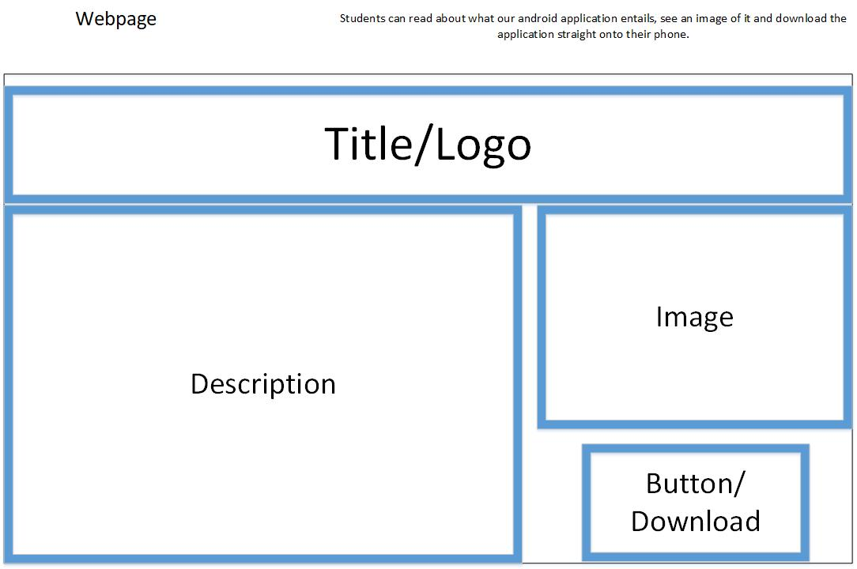
Website Design

Slide 3
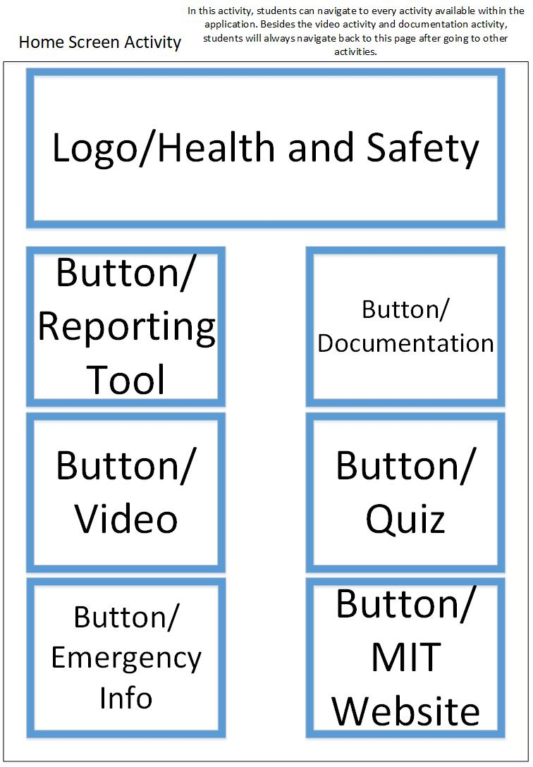
Application Design - Homepage

Slide 4
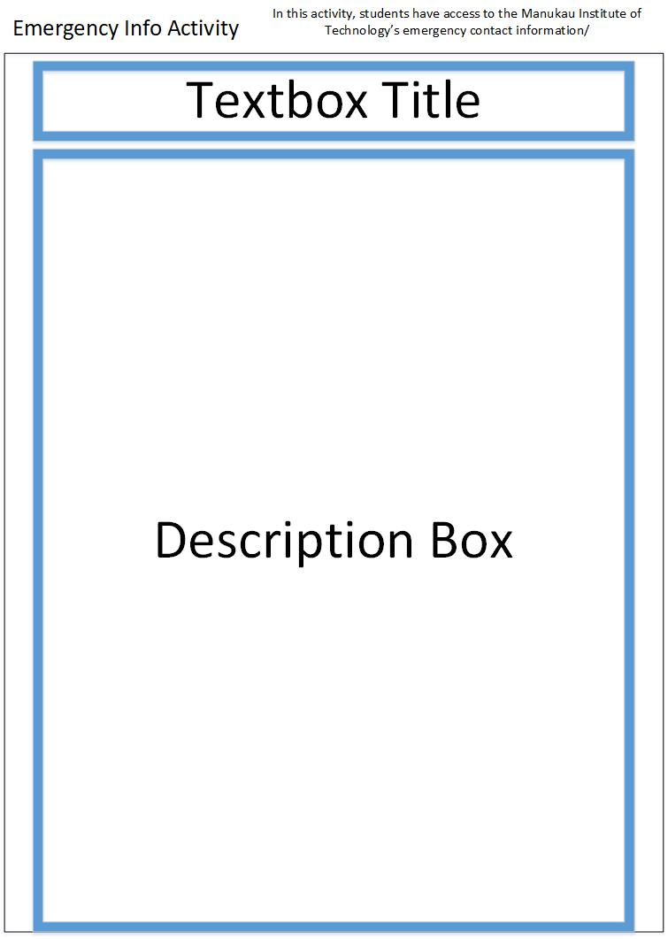
Application Design – Emergency Info

Slide 5
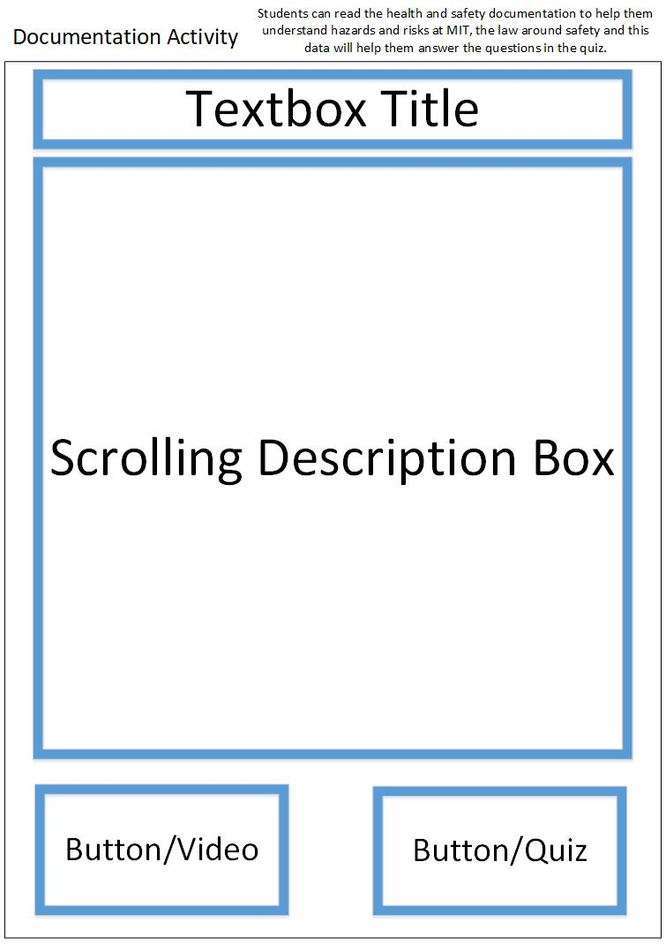
Application Design - Documentation

Slide 6
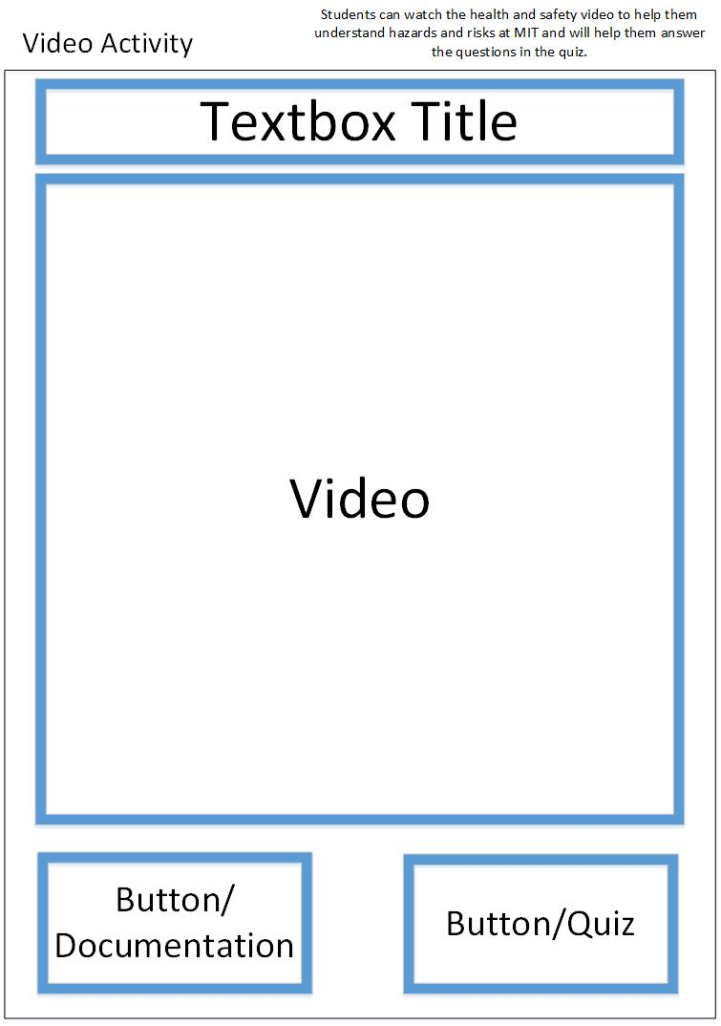
Application Design – Video

Slide 7
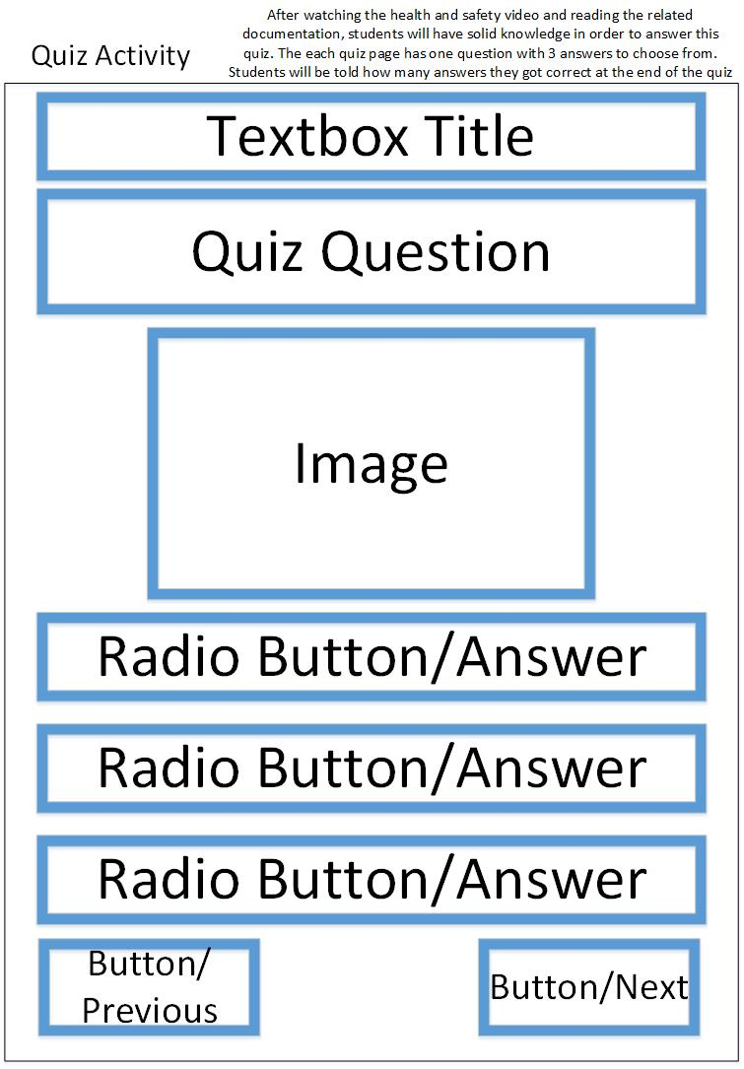
Application Design – Quiz

Slide 8
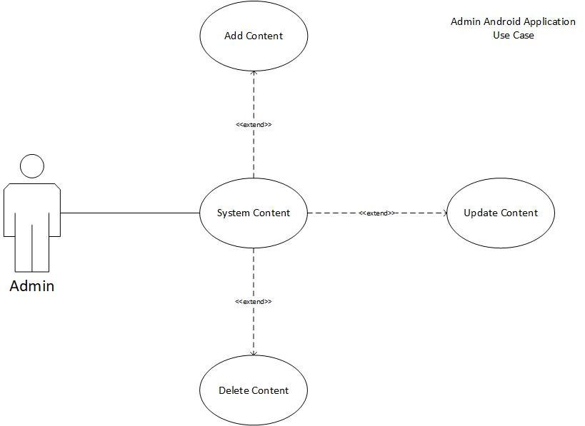
Application -Admin Use Case

Slide 9
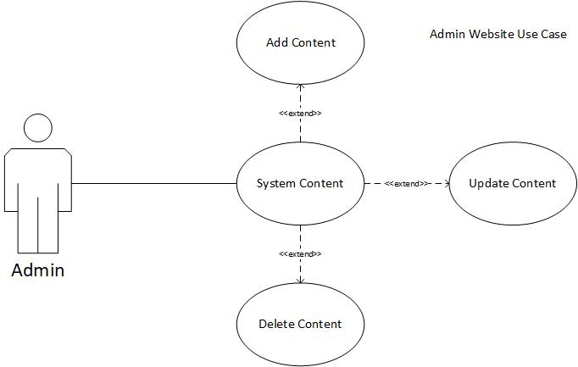
Website -Admin Use Case

Slide 10
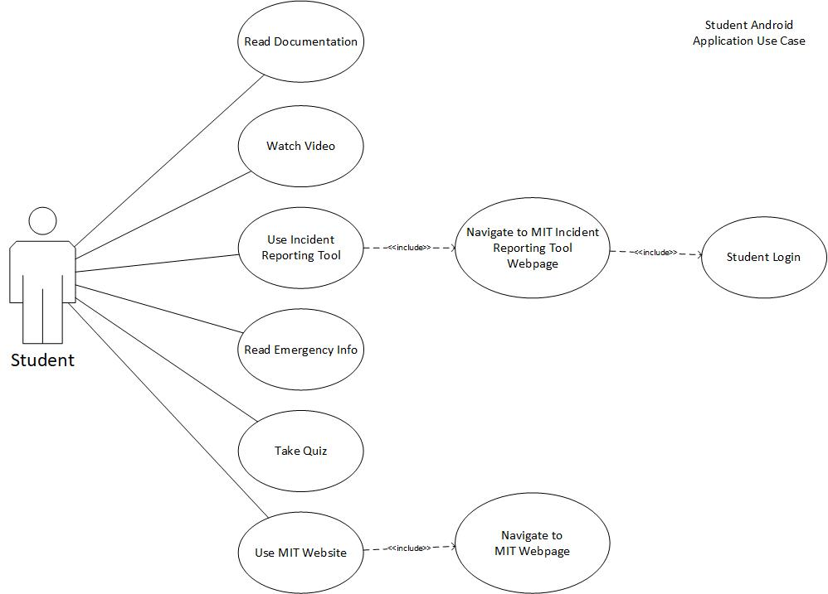
Application -Student Use Case

Slide 11
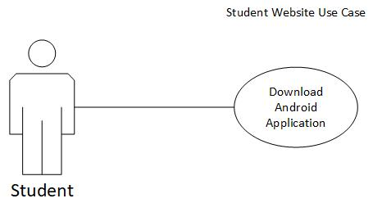
Website -Student Use Case

Slide 12
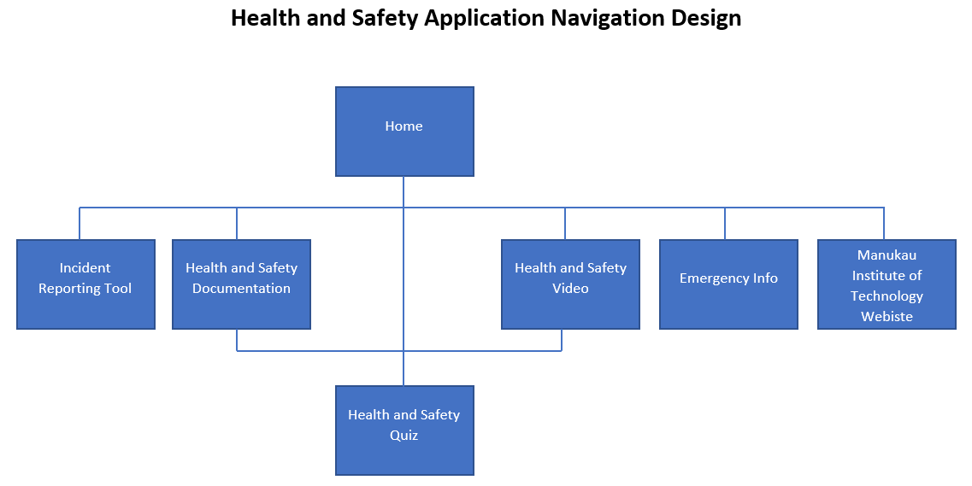
Application Navigation

Slide 13

Questions?

